Slide 1
Fast R-CNN (1)
Fast R-CNN
2024-11-25
Sein Choi
Intelligent Vision Processing Lab. (IVPL)
https://ivpl.sookmyung.ac.kr
Div. of AI Engineering, Sookmyung Women’s University
E-mail: csi1806@sookmyung.ac.kr

Slide 2
Contents
Introduction
R-CNN, SPPnet(SPP, SPM)
Tofu

Slide 3
Introduction
Improving Accuracy Across Various Tasks Using ConvNet
For object detection, complexity -> use multi-stage pipeline
Two Major Challenges in Addressing Complexity
Handling numerous region proposals
2. Need for precise location refinement
To address these, there is a trade-off involving speed, accuracy, and simplicity.
Solution:
Propose single-stage training algorithm
= classify object proposals + refine spacial locations
Results:
Training Speed : The proposed method is 9 times faster than R-CNN and 3 times faster than SPPnet on VGG16.
Inference Time: The inference time is 0.3 seconds per image.
mAP: Achieved 66% on Pascal VOC 2012, compared to 62% for R-CNN.

Slide 4
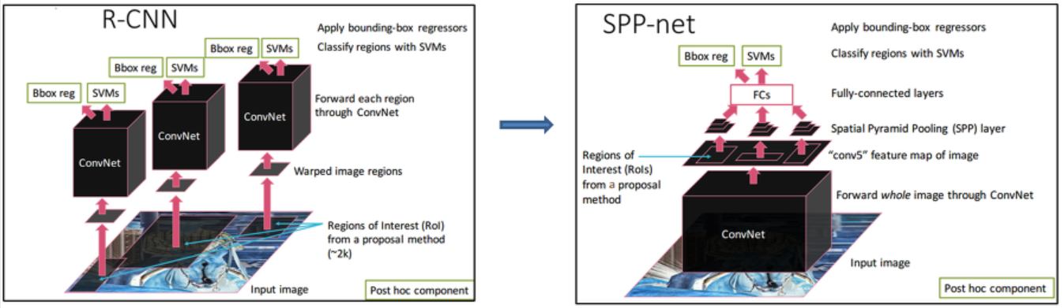
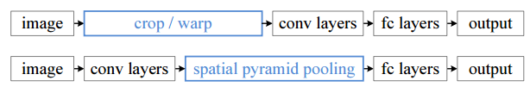
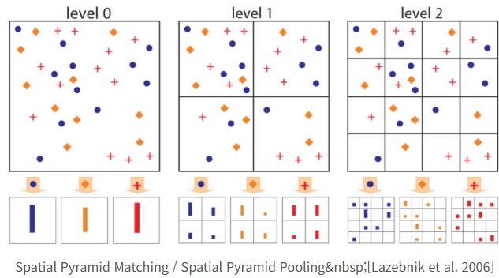
R-CNN and SPPnet
Difference of R-CNN and SPPnet
What is SPPnet?
Reason for R-CNN's slowness: without sharing computation.
SPPnet's proposal: apply computation sharing to speed up R-CNN.
Compute Conv feature map for the entire input image.
Use feature vectors extracted from the shared feature map to classify each region proposal.
Connect after pooling with multiple output sizes, similar to spatial pyramid pooling (citing SPM paper).
Advantages of SPPnet
Test time acceleration: 10-100 times faster.
Training time reduction: 3 times shorter.
Vectors: SPP, SPM
SPP : 3 (w.pooling)
SPM : 16
Disadvantages of R-CNN
Training is a multi-stage pipeline
Training is expensive in space and time
Object detection is slow
Disadvantages of SPPnet
Complex multi-stage training process.
Need to store features on disk every time.
Need to train SVM and bounding box regressor separately.
Major disadvantage: Cannot update/train layers preceding spatial pyramid pooling.

Slide 5
Thank you for your attention.!!!
QnA

Slide 6
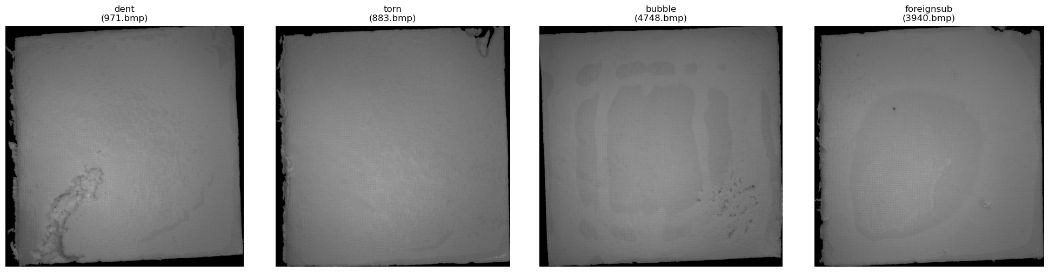
목적 데이터
목표: annotation 되지 않은 raw 두부 이미지 데이터를 데이터 전처리로 비지도 학습,
학습 결과로 labeling 진행, OK 데이터와 합쳐서 multilabeling classification 지도학습 예정
목적: 이미지 데이터의 충분한 이해,
사람이 검수를 최소화, 자동화된 라벨링 알고리즘 구축 시도
Class:
defect_images = [
{'file': '971.bmp', 'category': 'dent'}, #패임
{'file': '883.bmp', 'category': 'torn'}, #찢김
{'file': '4748.bmp', 'category': 'bubble'}, #기포
{'file': '3940.bmp', 'category': 'foreignsub'} #이물질
]

Slide 7
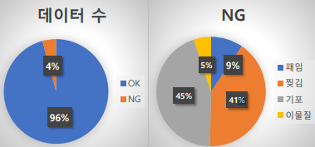
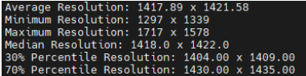
목적 데이터
데이터 개수
(NG는 눈으로 보고
직접 분류한 결과)
OK | NG
3549 | 156
NG | dent 패임 | torn 찢김 | bubble 기포(표면) | foreignsub 이물질
156 | 15 | 64 | 70 | 7
해상도

Slide 8
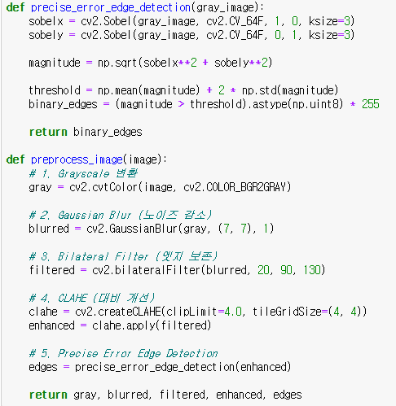
전처리 방법

Slide 9
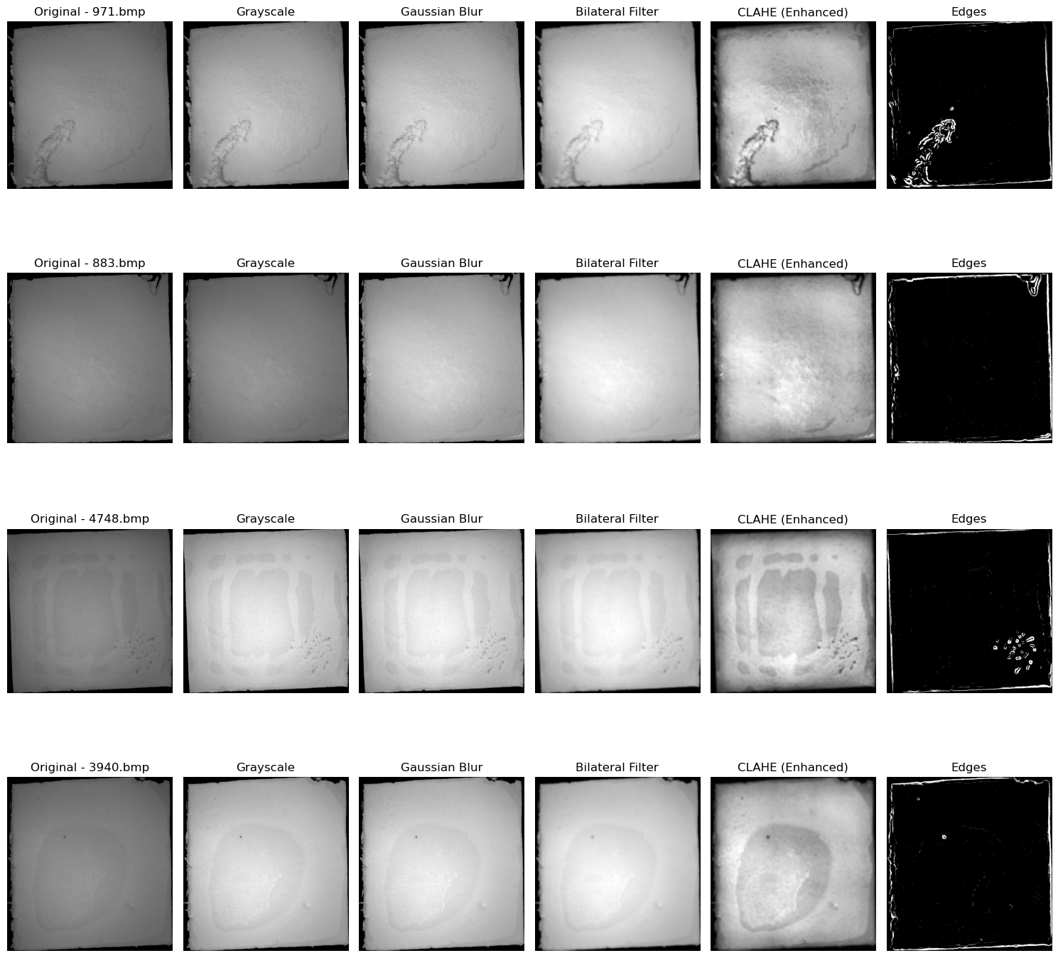
전처리 결과
dent
torn

Slide 10
전처리 결과
bubble
foreign sub

Slide 11
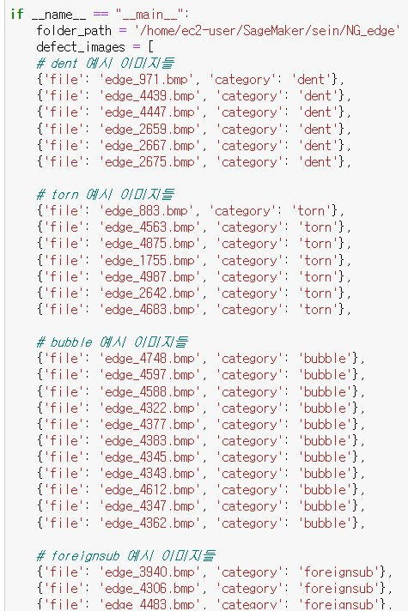
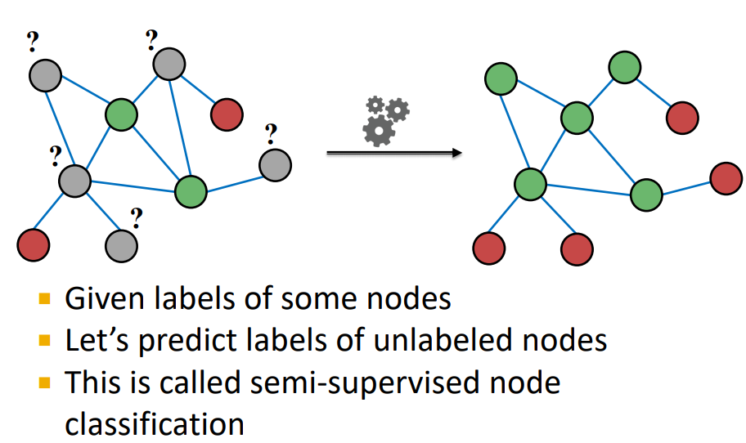
클래스 분류
반지도학습 사용
LabelPropagation 모델

Slide 12
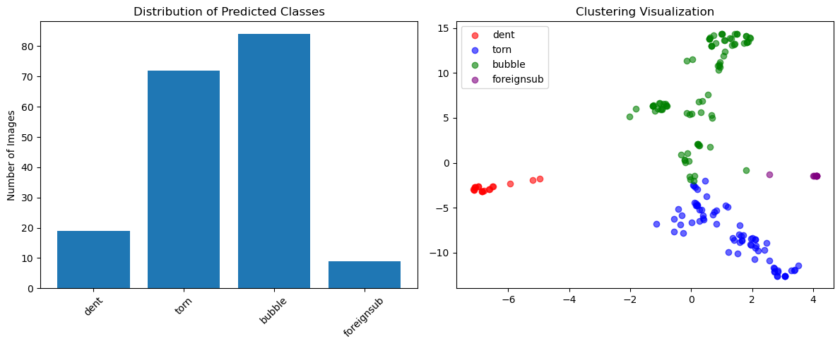
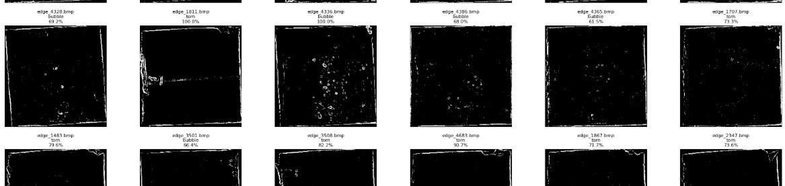
클래스 분류 결과
반지도학습 사용

Slide 13
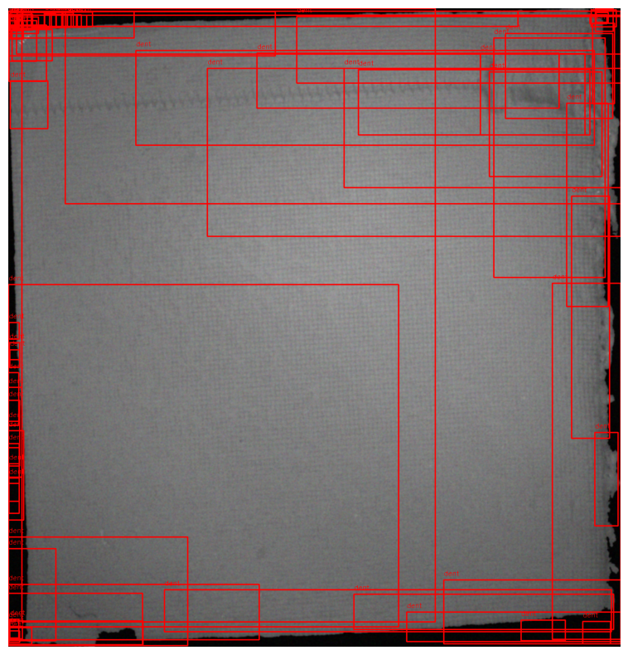
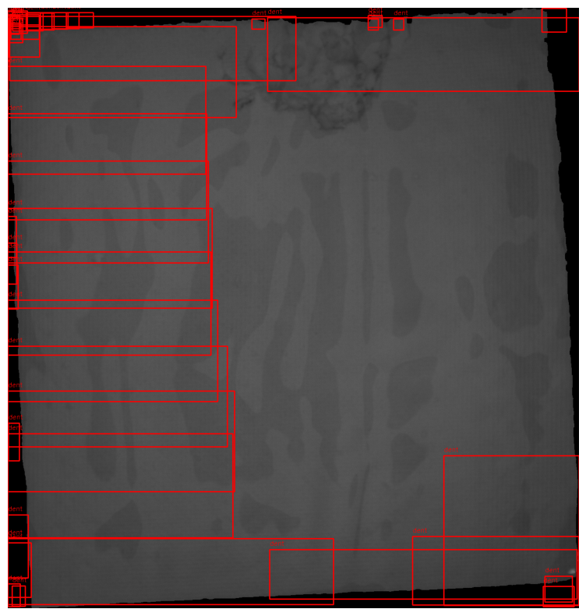
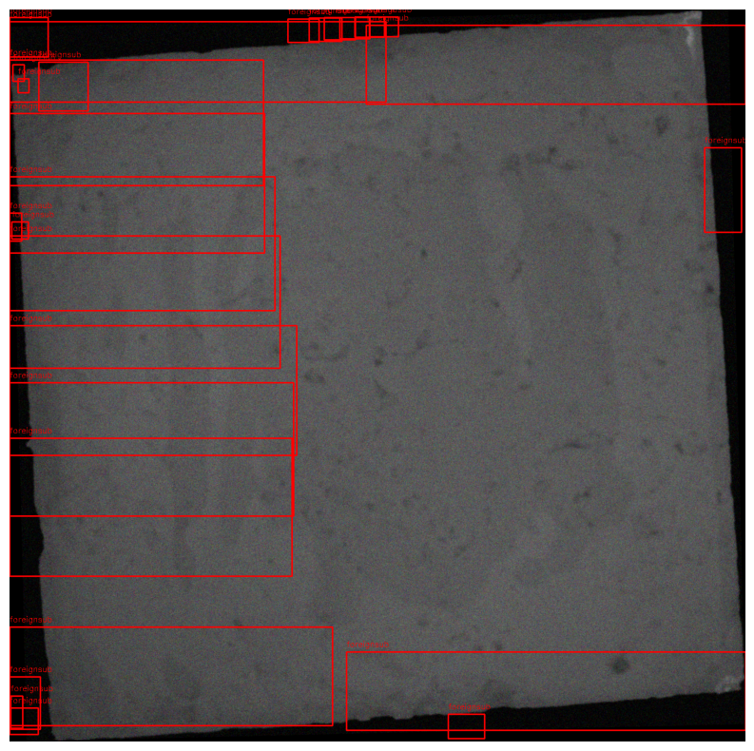
R-CNN 실험

